Slide 1
Databases Are Amazing!

Slide 2
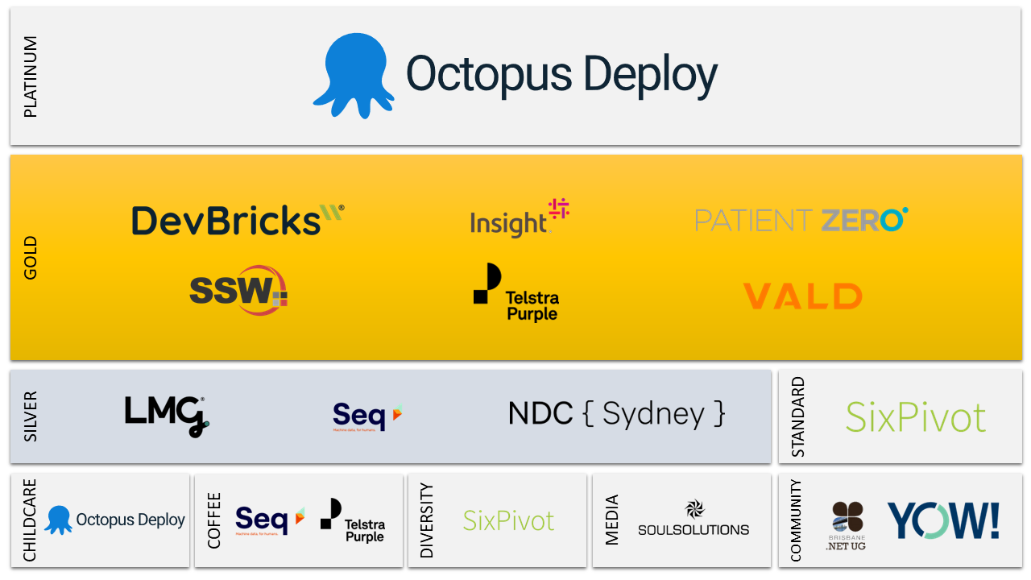

Slide 3
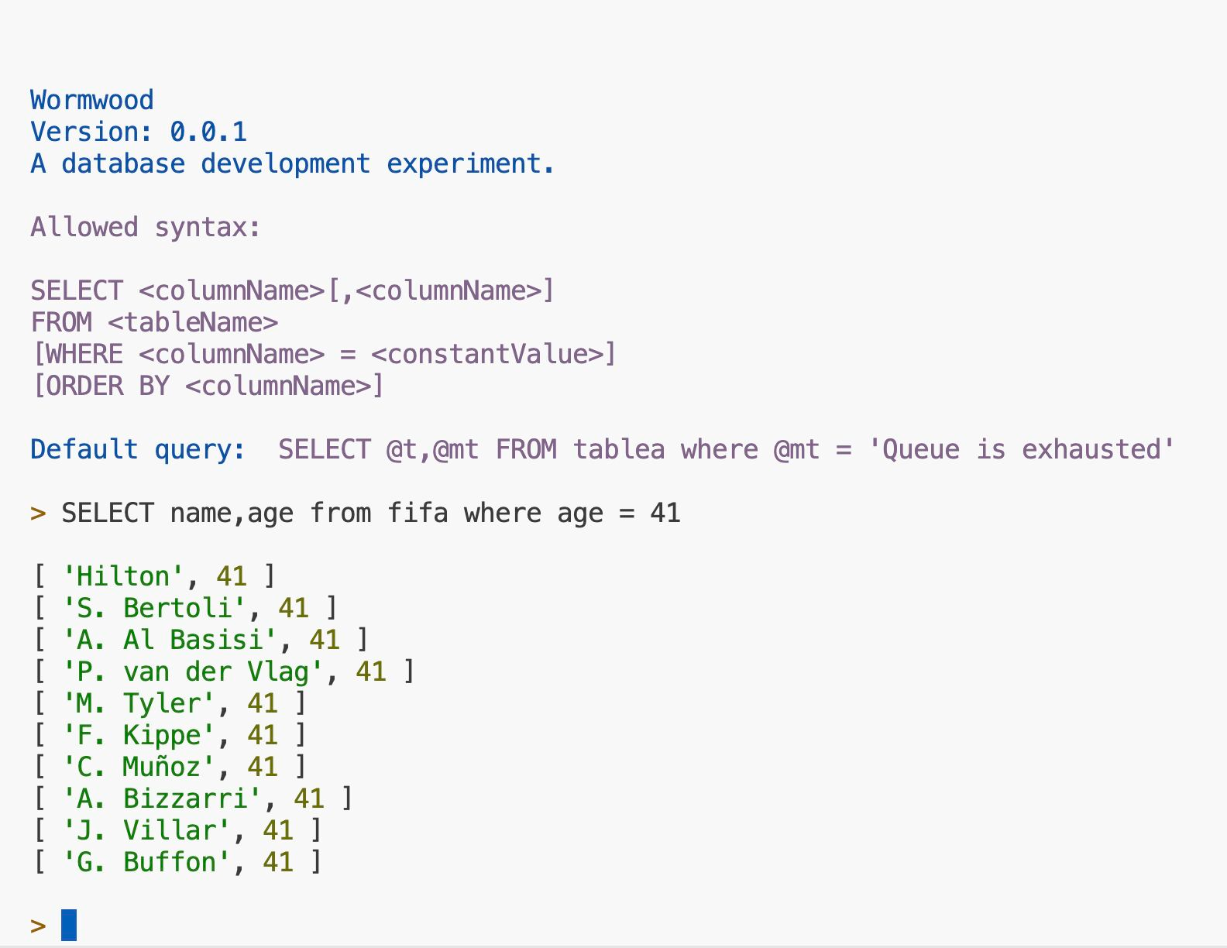
Wormwood
Notes:
Schemaless, read-only, sql-ish
Primary goal = easy to understand
660 LOC
Compelling demo – homebrew shell –source data, select, where, order by, mean

Slide 4
Read side
command = { command: "SELECT",
fields: ["name","age"], source: "fifa", filterProperty: "age", filterValue: 41, }
plan = [ ProducerStep("fifa",["name","age"])
FilterStep("age",41),
]
select name,age from fifa
where age = 41
Interface
Parser
Planner
Executor
Notes:
Day in the life

Slide 5
export async function evaluate(input: string): Promise<Iter> {
const command = Parser.parse(input);
const plan = await Planner.plan(command);
return Executor.run(plan);
}
Parser
Planner
Executor

Slide 6
The Parser
Filter parser
Source parser
Field parser
SELECT parser
SELECT name,age FROM fifa ...
Notes:
What is the parser’s job?
What is its design?

Slide 7
The Parser
command = { command: "SELECT",
fields: ["name","age"], source: "fifa", filterProperty: "age", filterValue: 41, }

Slide 8
function queryParser(q: string): Query {
var [fields, aggregation, rest] = fieldsParser(q);
var [source, rest] = tableParser(rest);
var [filter, rest] = filterParser(rest);
var [orderBy, rest] = orderByParser(rest);
return {
type: "query",
columns: fields,
source,
aggregation,
filter,
orderBy,
};
}
Notes:
Questions about parser?

Slide 9
The Planner
FilterStep ("age" = 41)
query = { command: "SELECT",
fields: ["name","age"], source: "fifa",
filter: ["age",41] }
ProducerStep (fifa, "name","age")
Notes:
What does the planner do?

Slide 10
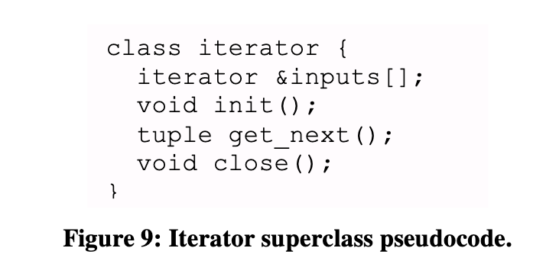
Dataflow Step Interface
export interface Iter {
next(): Row | EndOfFile;
}
Anatomy of a Database System
Joseph M. Hellerstein and Michael Stonebraker

Slide 11
export class Filter implements Iter { constructor(source: Iter, filterStep: FilterStep) {…}
}
async next(): Promise<Row | EndOfFile> {
let row = await this.source.next();
while (row !== "end of file") {
// `this.property` not found then columns[-1] is `undefined`
if (row[this.columns.indexOf(this.property)] === this.value) {
return row;
}
row = await this.source.next()
}
return row;
}

Slide 12
The Executor
export interface Iter {
next(): Row | EndOfFile;
}
next()
FilterStep ("age" = 41)
Filter
next()
ProducerStep (fifa, "name","age")
Producer
Notes:
What does the executor do?
Questions about query side of database?

Slide 13
A bit of complexity analysis
Randall Munroe
Notes:
Categorize algorithms by how the work changes with respect to the size or complexity of the problem.

Slide 14
n

Slide 15
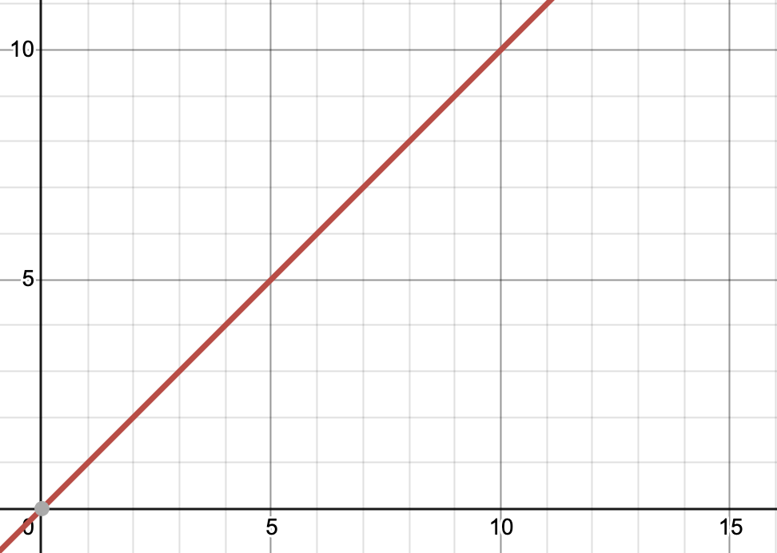
O(n)
work
problem
Notes:
What does O(n) mean?

Slide 16
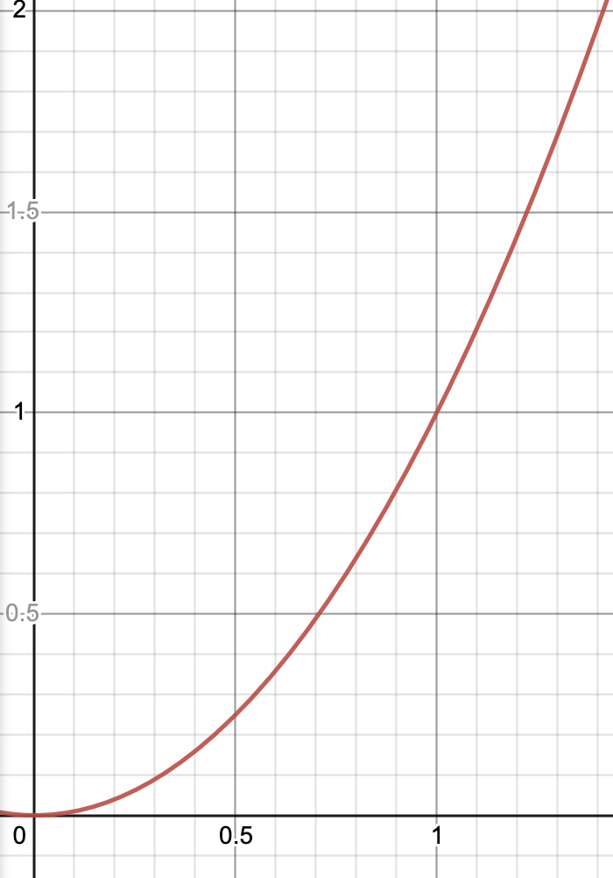
O(n²)
work
problem
Notes:
What does O(n2) mean?
Polynomial time. Pairing all the values in a list, or any nested for loop over the input.

Slide 17
O(2^{n})
work
32 character password.
149,813 Unicode characters
Therefore 149,813³² combinations
= 4145568 0000000000 0000000000 0000000000 0000000000 0000000000 0000000000 0000000000 0000000000 0000000000 0000000000 0000000000 0000000000 0000000000 0000000000 0000000000 000000000
problem
Notes:
What does O(2n) mean?
Exponential time. Calculataion of permutations and combinations. Cracking passwords.

Slide 18
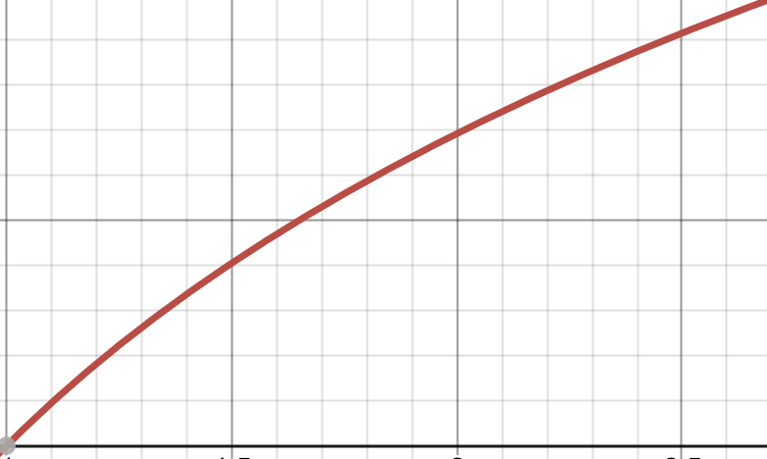
O(log n)
work
problem
Notes:
Logarithmic time

Slide 19
O(2n) ?
Notes:
Big-O is asymptotic analysis – concerned with behaviour as n grows to infinity – so n and 2n are the same.

Slide 20
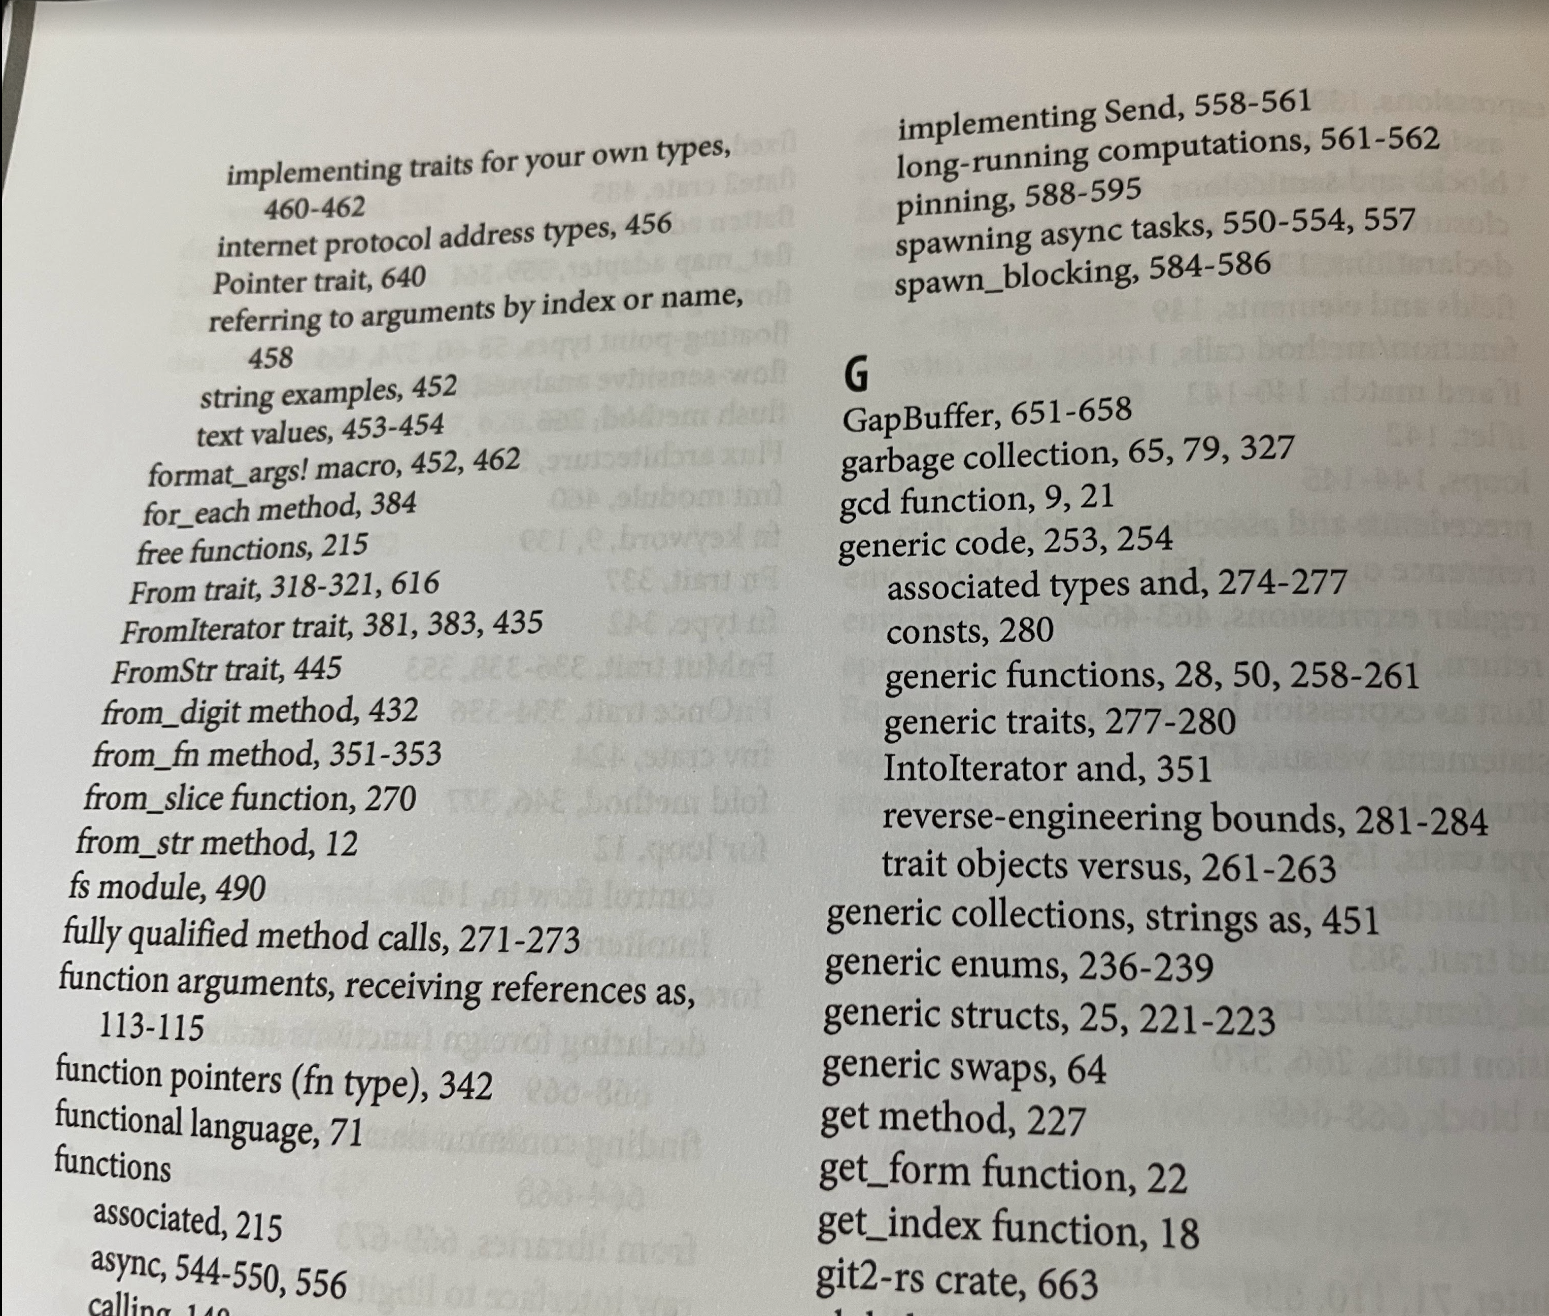
Indexes
Notes:
Why do we/ don’t we index data?
What is an index?
Row scan is O(n)
Indexes: entries have key and value, sorted, grouped .

Slide 21
Finding ‘generic enums’ in Programming Rust 2nd Ed
Unsorted case
Notes:
How would we find a value in unsorted data?
Full scan. O(n).

Slide 22
Finding ‘generic enums’ in Programming Rust 2nd Ed
Sorted case
Notes:
How would we find a value in sorted data?
O(log n)

Slide 23
Finding ‘generic enums’ in Programming Rust 2nd Ed
Indexed case
Notes:
How would we find a value in indexed data?
O(log n).
What is a B-tree?!

Slide 24
Indexes
Book indexes are two-level B-trees with branching factor = 26
Notes:
What is the relationship between a book index and a database index?
Indexes: entries have key and value, sorted, grouped.

Slide 25
Binary search B-Tree
Sorted
O(log n)
Indexed
O(log n)
Notes:
How do binary search and b-tree search compare?
Do those complexities mean they perform the same?

Slide 26
A digression…
Why do we say O(log n) with no log base?
Notes:
12:45

Slide 27
t = O(log n)
x
means
n = x^{t} = x₁ * x₂ * ..x_{t}
Notes:
The time to perform a task of size n is the number of times an unknown value x must be multiplied by itself to reach n.
Larger problem = more times multiplying unknown x by itself.

Slide 28
But…!
x₁ * x₂ * ..x_{t} = C(y₁ * y₂ * ..y_{t})
Constants multipliers are deleted from O classification (O(n) = O(2n)) therefore,
O(log₂n) = O(log₁₀n) = O(log n)
□
Notes:
The time to perform a task of size n is the number of times an unknown value x must be multiplied by itself to reach n.

Slide 29
Binary search B-Tree
Sorted
O(log₂n)
Indexed
O(log_{b}n)
Notes:
B is branching factor. Each step down b-tree reduces the problem space by factor B. Databases tend to use high B. Actual values based on cache locality and IO properties such as page size.
A two-way branching b-tree is binary search.

Slide 30
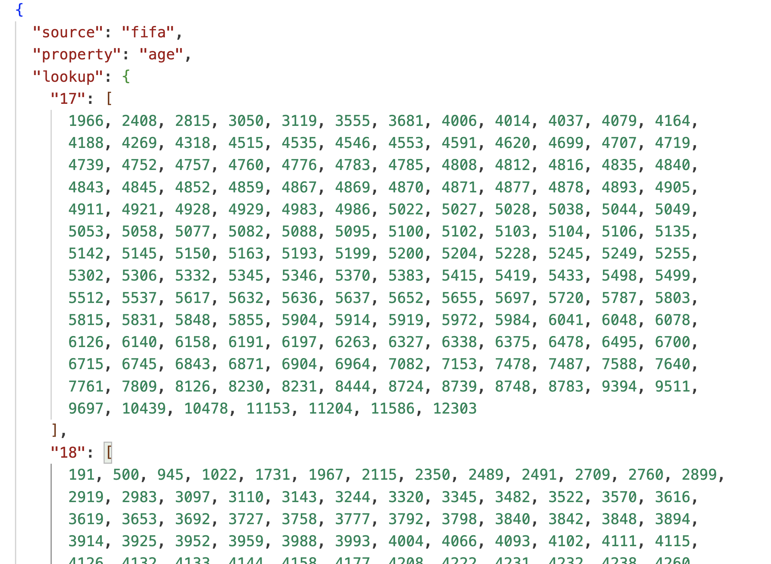
Wormwood index demo
Notes:
sp_createIndex(fifa,age)
select name,age from fifa where age = 41

Slide 31
Homework
Encoding
Endianess
Variable sized data
Row-oriented / column oriented
Write ahead logs
Transactions
Multi-version concurrency control
Immutable log-structured merge trees
Write amplification

Slide 32
Databases are amazing
See Wormwood
Read side = chain of iterators
Indexes are just like book indexes
Log subscript doesn’t matter (but it does)
Ask me questions!
Notes:
What are the “take aways”?

Slide 33


